Slide 1

CSE221: Algorithms
Linear Time Sorting Algorithms
Prepared by: A B M Muntasir Rahman [MUNR]

Slide 2
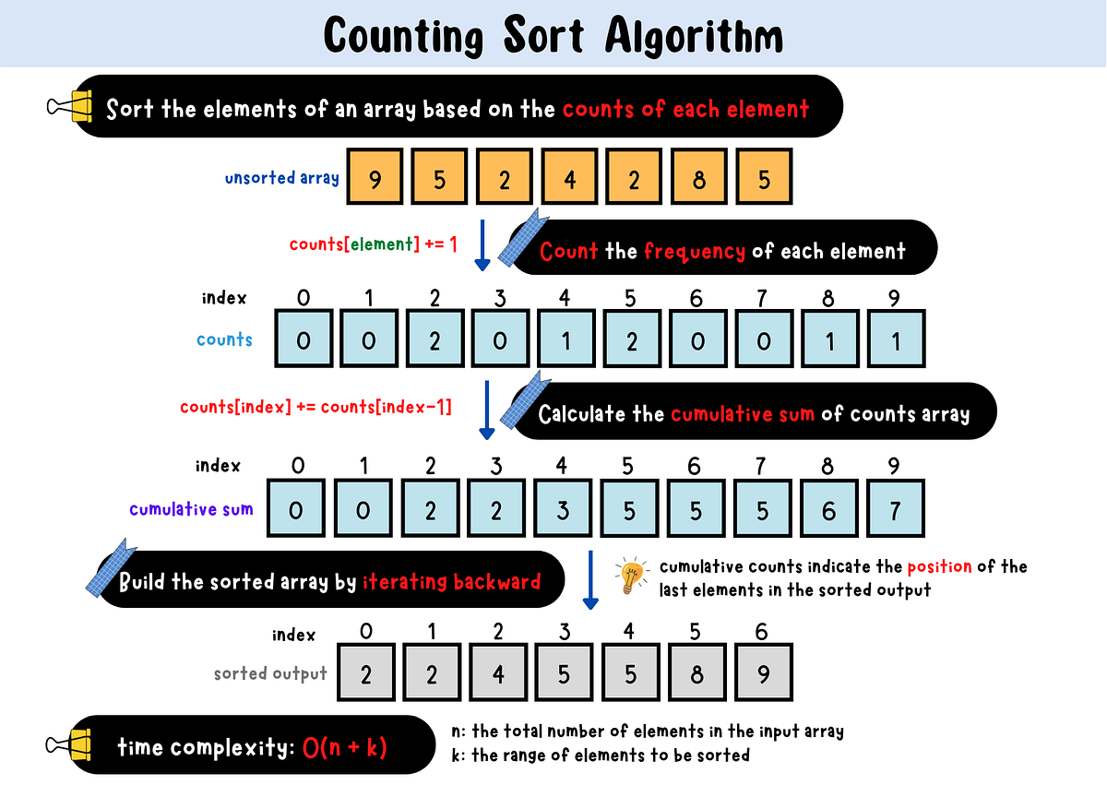
Counting Sort
A sorting algorithm that sorts the elements of an array by counting the number of occurrences of each unique element in the array.
Counting Sort does not compare values like the previous sorting algorithms we have looked at, and only works on non negative integers.

Slide 3
Conditions
Non-negative integer values: Counting Sort relies on counting the occurrences of distinct values, so the elements must be integers. With non-negative integers, each value can directly correspond to an index in the counting array. If a value is negative, it cannot be mapped to a valid array index, making the algorithm unsuitable without modification.
Limited range of values: If the number of possible different values to be sorted is larger than the number of values to be sorted, the counting array we need for sorting will be larger than the original array we have that needs sorting, and the algorithm becomes ineffective.

Slide 4
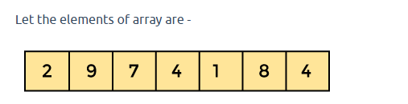
Simulation

Slide 5
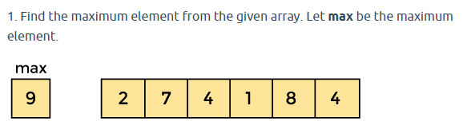
Simulation

Slide 6
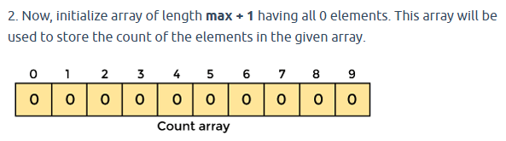
Simulation

Slide 7
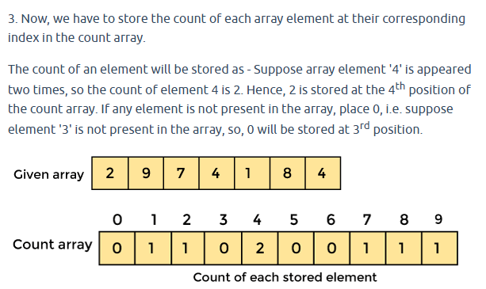
Simulation

Slide 8
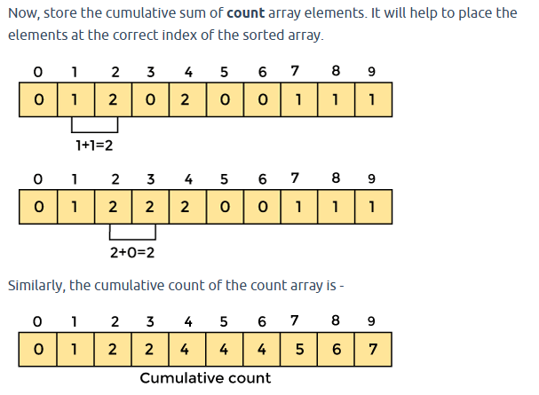
Simulation

Slide 9
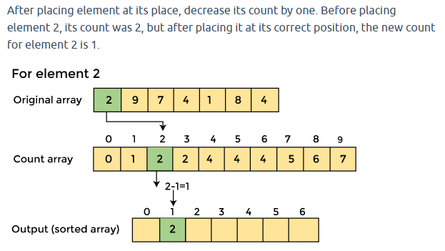
Simulation

Slide 10
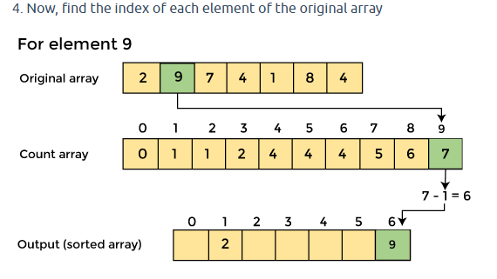
Simulation

Slide 11
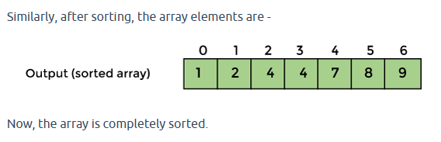
Simulation

Slide 12
Pseudocode
countingSort(array)
max_val <- maximum value in array
create count[0...max_val] initialized to 0
for each num in array
count[num] <- count[num] + 1
for i <- 1 to max_val
count[i] <- count[i] + count[i - 1]
create sortedArray[0...sizeOfArray - 1]
for each num in array (in reverse order)
count[num] <- count[num] - 1
sortedArray[count[num]] <- num
return sortedArray

Slide 13
Properties
Time Complexity:
  Best/Average/Worst case: O(n + k) where n is the number of elements in the input array, and k is the range of input values.
Space Complexity:
  Best/Average/Worst case: O(n + k) (for the count array and output array).
Stable: Yes.
In-place: No.
Suitable for arrays where the range (k) of input values is not significantly larger than the number of elements (n). Not suitable when k>>n, as it increases memory usage.

